Slide 1
Recruit Strategizer Sub-Workflow
AI-Driven Pipeline Analysis, Bottleneck Detection & Strategy Reporting
Sub-workflow Documentation · Part of the Pipeline Health Monitor System · Built on n8n

Slide 2
What This Sub-Workflow Does
Called by the main Pipeline Health Monitor workflow via an Execute Workflow node.
Receives aggregated candidate health metrics as its input data payload.
An AI agent (Recruitment Strategiser) analyses the data to identify which stage — Interview, Offer, or Screening — is the biggest bottleneck.
Generates 4 concrete recommendations to improve hiring speed, formatted as a valid HTML report.
An Edit Fields node extracts and structures the output (Title, Text, Bottleneck Stage, Recommendations, HTML Report).
A Gmail node emails the HTML strategy report to the HR manager.
A separate error-handling branch catches any AI failures, logs them to Google Sheets with a timestamp, and sends an alert email.

Slide 3
Complete Node Inventory – 22 Nodes
Entry
Output Path
Start (executeWorkflowTrigger)
Edit Fields (format output fields)
Main AI Path
Send a message (Gmail – HTML report)
recruitment strategiser (AI Agent)
Error Handling Path
Mistral Cloud Chat Model2 (primary LLM)
error handler for recruitment advisor (AI Agent)
OpenRouter Chat Model1 (GPT-4o fallback)
Mistral Cloud Chat Model4 (primary LLM)
Simple Memory1 (buffer window, 30 turns)
OpenRouter Chat Model3 (GPT-4o-mini fallback)
Mistral Cloud Chat Model10 (parser LLM)
Simple Memory3 (buffer window, 1000 turns)
Structured Output Parser5
Mistral Cloud Chat Model5 (parser LLM)
Structured Output Parser2 (TimeStamp|Error|Solution)
Edit Fields4 (extract error fields)
Append or update row in sheet1 (Google Sheets log)
Send a message2 (Gmail – alert email)

Slide 4
🚀
Entry Point – Start Node
How the sub-workflow receives data from the main workflow

Slide 5
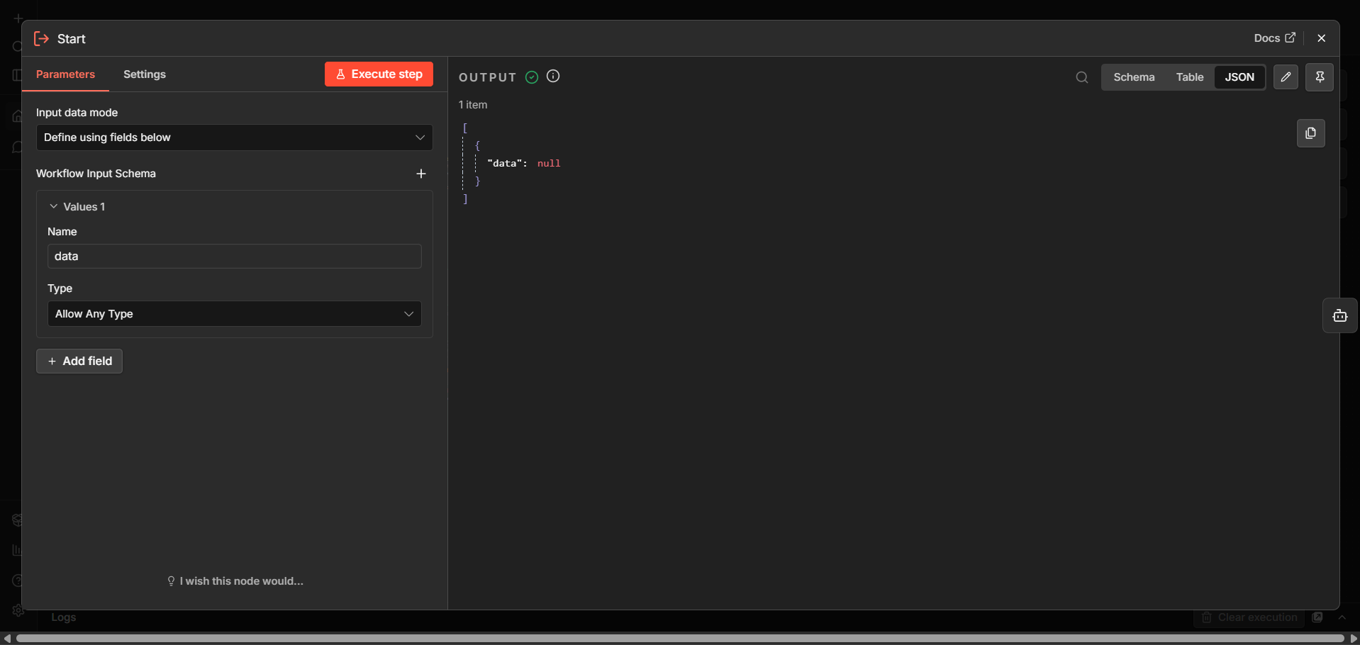
Start Node – executeWorkflowTrigger
Node type: n8n-nodes-base.executeWorkflowTrigger
Input mode: Define using fields below
Accepts a single field named 'data' with type: Allow Any Type
Acts as the sub-workflow's entry gate — passthrough mode means all incoming data is forwarded as-is to the recruitment strategiser agent
Called by 'Call WEEK4 Recruit Strategiser' node in the parent workflow using executeWorkflow
The payload is the aggregated pipeline metrics JSON built by the main workflow's Aggregate node

Slide 6
🤖
Recruitment Strategiser Agent
The AI brain — bottleneck detection and recommendations

Slide 7
Recruitment Strategiser – Agent Prompt & Output Schema
Agent Prompt (User Message)
Output JSON Schema
Analyze the pipeline metrics gotten from the previous nodes.
Identify the bottleneck stage (Interview, Offer, Screening).
Give 4 useful recommendations to improve hiring speed.
Format the output as valid HTML (use <ul> for lists and <b> for bolding).
bottleneck_stage:
The stage with the biggest delay
(Interview / Offer / Screening)
recommendations:
Array of 4 actionable items
to improve hiring speed
html_report:
Full HTML response with
<ul> lists and <b> bolding
autoFix: true — self-repairs
malformed AI JSON output

Slide 8
Recruitment Strategiser – AI Model Stack
Primary: Mistral Cloud Model2
Fallback: OpenRouter Chat Model1
devstral-medium-latest
openai/gpt-4o
Temperature: 0.3
Max Tokens: 100
Max Retries: 2
Safe Mode: ON
Role: Main inference engine for bottleneck detection and recommendations
Temperature: 0.3
Max Tokens: 100
Max Retries: 2
Activates automatically if Mistral fails
Ensures zero-downtime strategy generation
Memory: Simple Memory1
Output Parser: Structured Output Parser5
Buffer Window — 30 turns
Parser LLM: devstral-medium-latest
Session key: $now (timestamp)
Context window: 30 messages
Reset on each execution cycle
Keeps strategy context coherent during multi-step analysis
Schema: bottleneck_stage | recommendations | html_report
autoFix: true
Enforces strict JSON schema on all AI responses
Parser powered by Mistral Cloud Model10 (temp 0.7)

Slide 9
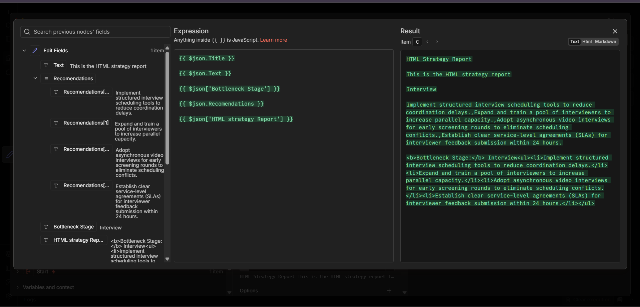
Edit Fields Node – Structuring the Strategy Output
Receives raw output from the recruitment strategiser agent
Extracts and maps 5 output fields:
• Text → 'This is the HTML strategy report'
• Recommendations → $json.output.recommendations (array)
• Bottleneck Stage → $json.output.bottleneck_stage
• HTML strategy Report → full HTML content
• Title → dynamically set label
Output feeds directly into the Gmail 'Send a message' node

Slide 10
📧
Output Delivery – HTML Strategy Email
Sending the bottleneck report to HR via Gmail

Slide 11
Send a Message – Gmail Strategy Report Node
Gmail Node Configuration
Sample Email Output
Node: Send a message (n8n-nodes-base.gmail)
To: pascalmungai850@gmail.com
Subject: HTML strategy report
Email Type: Text
Message body template:
{{ $json.Title }}
{{ $json.Text }}
Bottleneck stage: {{ $json['bottleneck stage'] }}
Recommendations: {{ $json.recommendations }}
Subject:
HTML strategy report
Body:
HTML Strategy Report
This is the HTML strategy report
Bottleneck Stage: Interview
Recommendations:
• Implement structured scheduling tools
• Expand interviewer pool
• Adopt async video interviews
• Establish 24hr feedback SLAs

Slide 12
⚠️
Error Handling Branch
Fault tolerance for the Recruit Strategizer — log, alert, recover

Slide 13
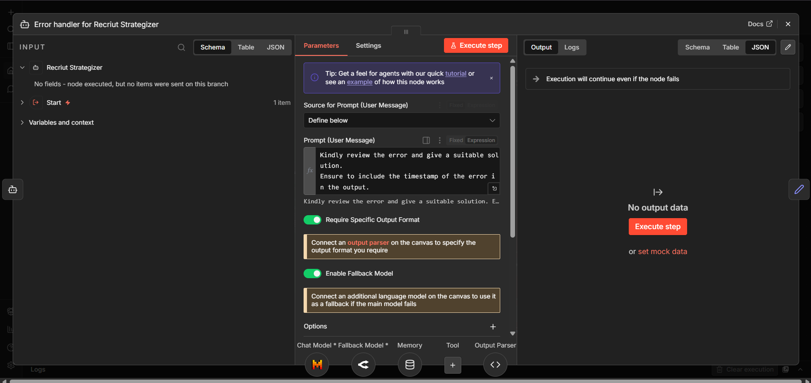
Error Handler Agent – Node Configuration
Triggered when the recruitment strategiser agent fails
Agent prompt: 'Kindly review the error and give a suitable solution. Ensure to include the timestamp of the error in the output.'
Require Specific Output Format: ON
Enable Fallback Model: ON (Mistral → GPT-4o-mini)
Has dedicated Chat Model, Memory, and Output Parser sub-nodes
Output schema: TimeStamp | Error | Solution

Slide 14
Error Handler – AI Model Configuration
Primary LLM: Mistral Cloud Model4
Model: devstral-medium-latest | Temp: 0.9 | Tokens: 100 | Retries: 2 | Safe Mode: ON
Higher temperature (0.9) chosen for more creative error diagnosis and solution suggestions
Fallback LLM: OpenRouter Chat Model3
Model: openai/gpt-4o-mini | Temp: 0.7 | Tokens: 100 | Retries: 2
Lighter GPT-4o-mini used as fallback — cost-optimised for error handling scenarios
Memory: Simple Memory3
Session key: $now | Context Window: 1000 turns
Large 1000-turn context window ensures the full error history is available for the agent's analysis across a long error chain
Output Parser: Structured Output Parser2
Schema: { TimeStamp: "", Error: "", Solution: "" }
autoFix: true | Parser LLM: devstral-latest (temp 0.7, safe mode ON, max tokens 1000)
High-token parser model ensures complete, well-formed error reports

Slide 15
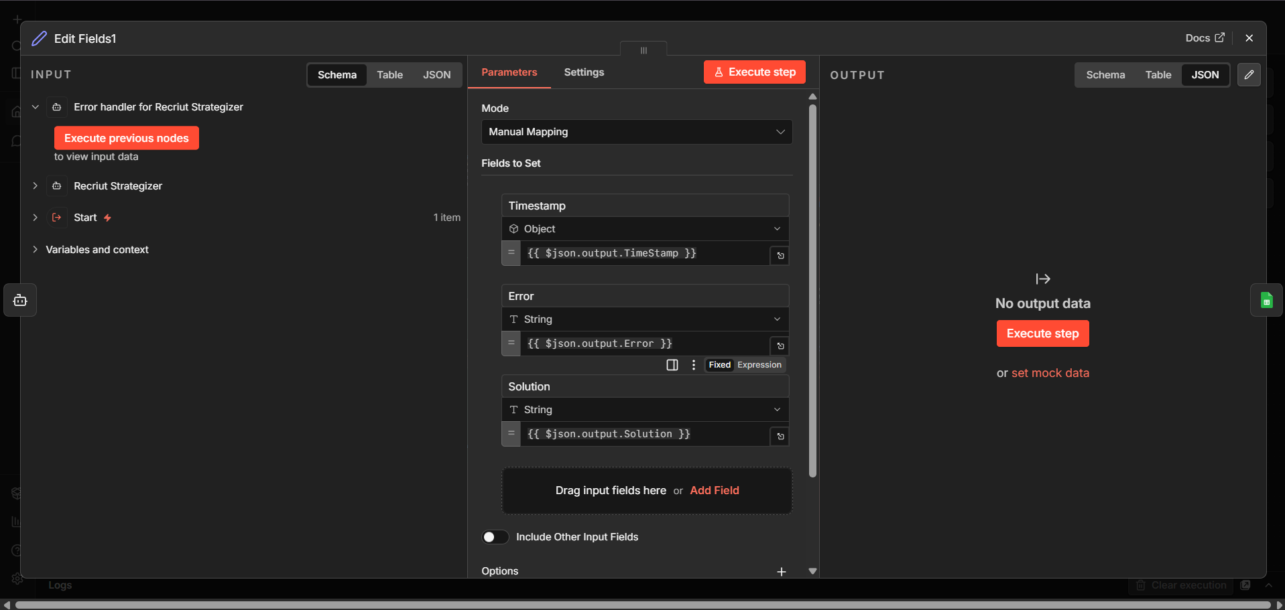
Edit Fields1 – Mapping Error Handler Output
Receives structured JSON from the error handler agent
Maps 3 fields for downstream logging:
• Timestamp → $json.output.TimeStamp (Object type)
• Error → $json.output.Error (String)
• Solution → $json.output.Solution (String)
Mode: Manual Mapping — fields defined explicitly
Output feeds into Append or Update Row in Sheet1 for persistent error logging

Slide 16
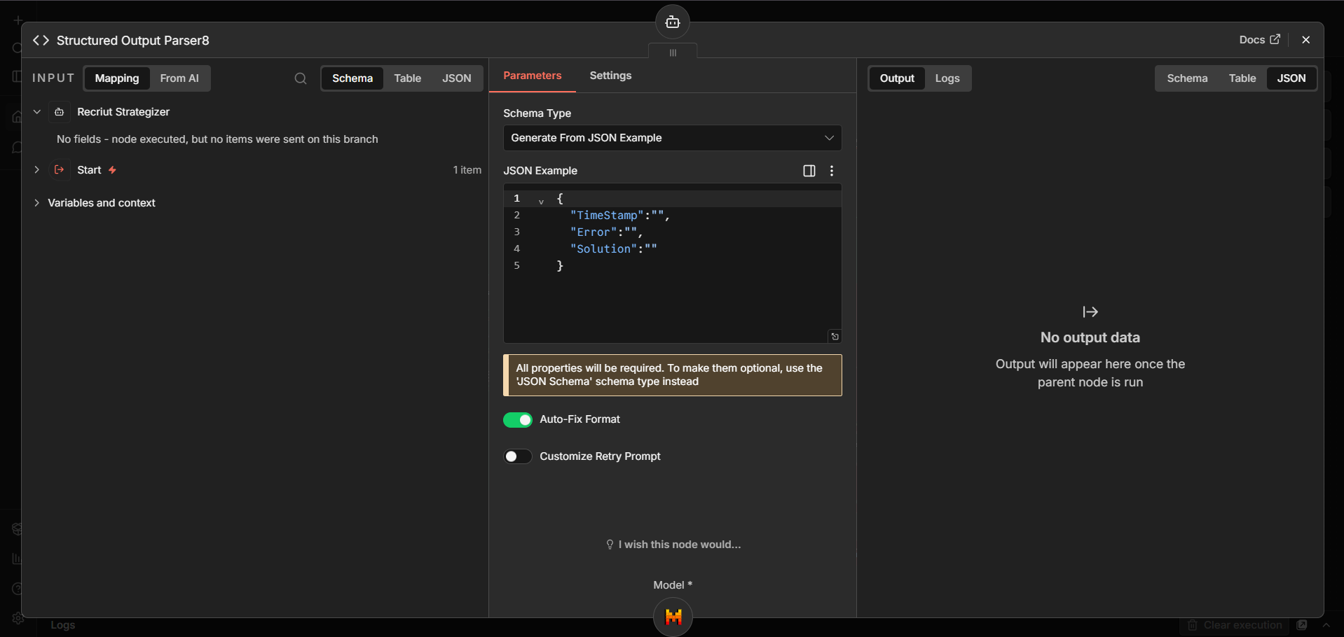
Structured Output Parser8 – Error Schema Definition
Schema Type: Generate From JSON Example
JSON Example: { TimeStamp: "", Error: "", Solution: "" }
All 3 properties are required fields
Auto-Fix Format: ON — self-repairs malformed AI responses
Customize Retry Prompt: OFF
Powered by Mistral Cloud Model — devstral-latest at temp 0.7
1000-token budget ensures complete error descriptions are captured

Slide 17
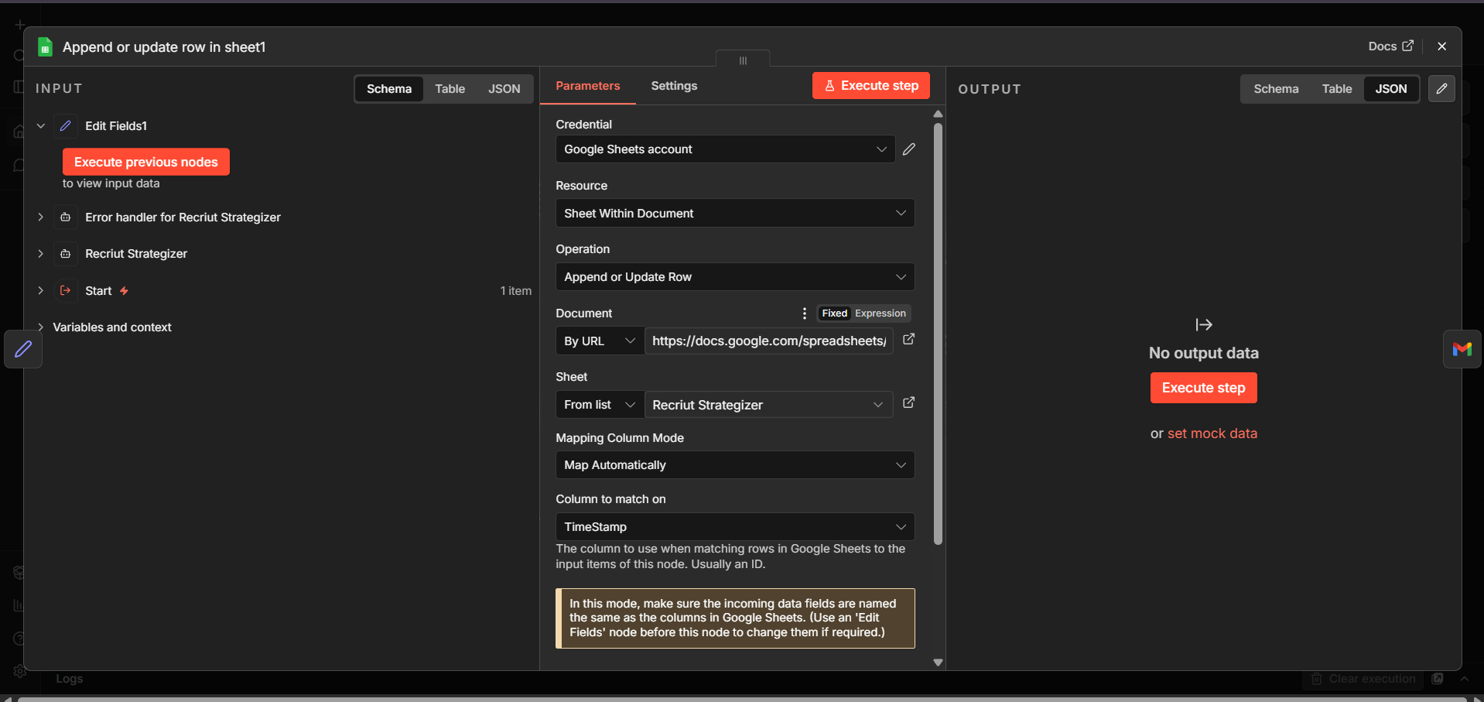
Append or Update Row in Sheet1 – Error Log
Node: n8n-nodes-base.googleSheets
Operation: Append or Update Row
Target sheet: 'Recruit Strategiser' tab
Document: Linked Google Spreadsheet (by URL)
Mapping Column Mode: Map Automatically
Column to match on: TimeStamp (used as unique row key)
Writes 3 columns: Timestamp | Error | Solution
Creates a permanent error log for audit and debugging

Slide 18
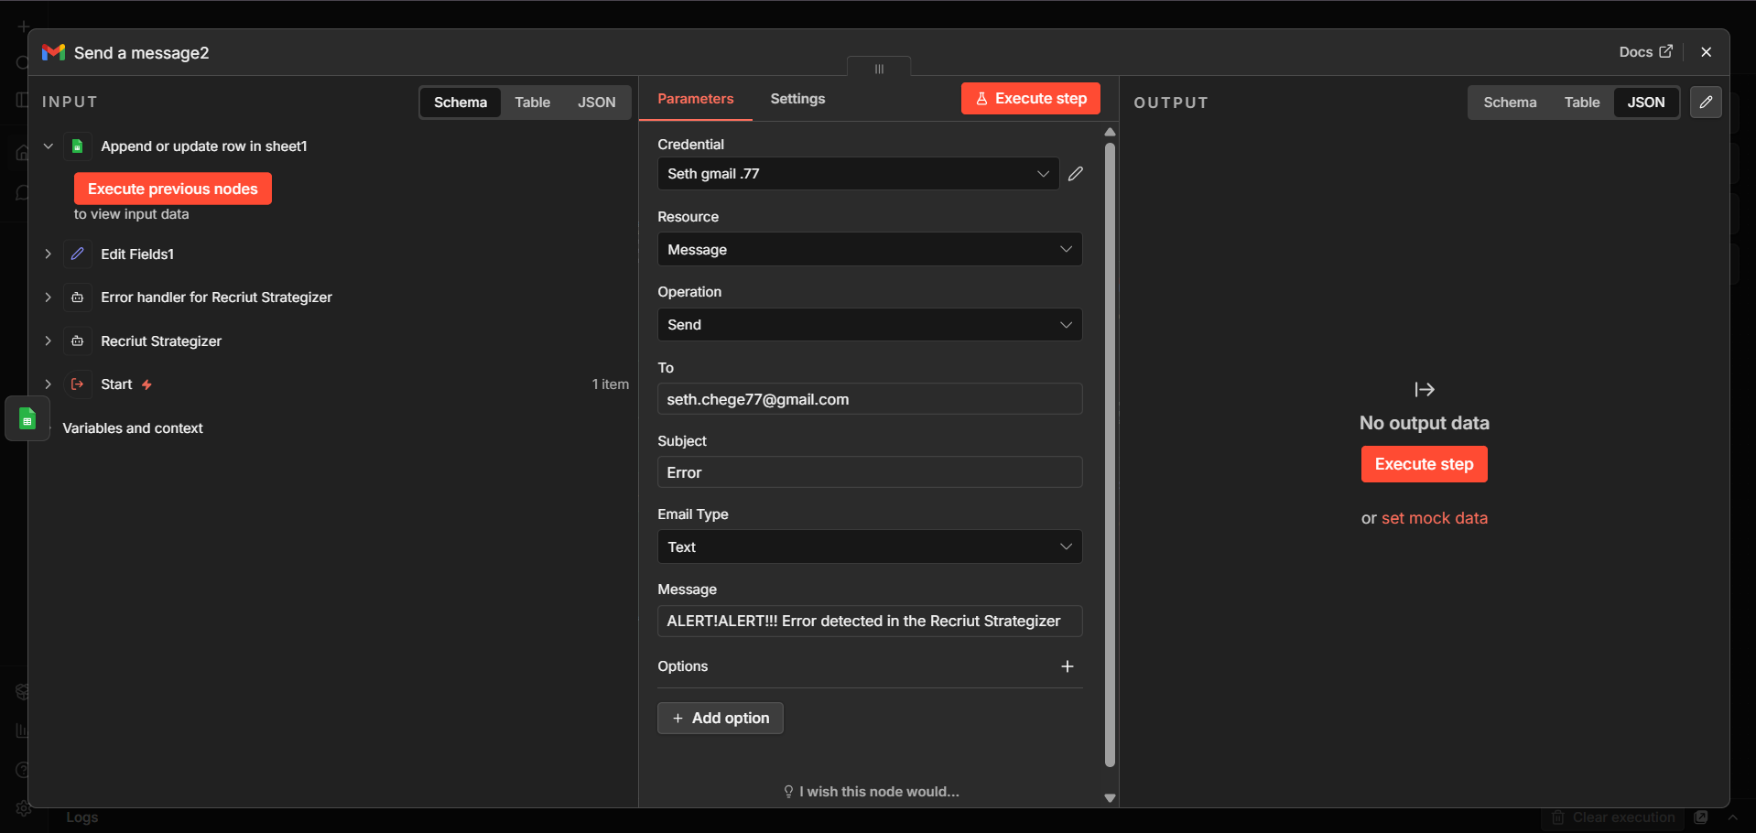
Send a Message2 – Error Alert Email Node
Node: Send a message2 (n8n-nodes-base.gmail)
Credential: Seth gmail .77
To: seth.chege77@gmail.com
Subject: Error
Email Type: Text
Message: 'ALERT!ALERT!!! Error detected in the Recruit Strategizer'
Fires immediately after the Google Sheets log — ensures the team is notified of every failure within seconds

Slide 19
End-to-End Flow – Recruit Strategizer Sub-Workflow
Start
(Trigger)
Recruitment
Strategiser
Agent
Edit
Fields
Send a
Message
(Gmail)
SUCCESS PATH
Error
Handler
Agent
Edit
Fields1
Append
to Sheet
Send
Alert
Email
ERROR PATH

Slide 20
Proposed Node Additions to Improve This Sub-Workflow
1. Webhook Response Node
2. HTML-to-PDF Conversion Node
Return the HTML report back to the parent workflow so it can display or further route the strategy output rather than just emailing it.
Add a Code node that converts the HTML report to a PDF attachment, making the emailed strategy report printable and shareable.
3. Conditional Routing by Bottleneck
4. Slack Notification Node
Add an IF/Switch node after Edit Fields to route different bottleneck stages (Interview vs Offer vs Screening) to tailored email templates.
Add a Slack node alongside Gmail to post the bottleneck stage and top recommendation directly into an HR Slack channel for instant visibility.
5. Historical Strategy Sheet Append
6. Retry Logic for Strategiser Agent
Add a Google Sheets append node on the success path to log every strategy report (date, bottleneck, recommendations) for longitudinal trend analysis.
Wrap the agent call in a loop with a Wait node — automatically retry up to 3 times before routing to the error handler, reducing false error alerts.

